Slide 1
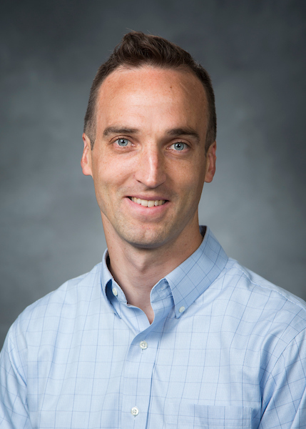
The Relationship of Context to Aspect in Russian: An Experiment
Laura A. Janda, UiT The Arctic University of Norway
Robert J. Reynolds, Brigham Young University

Slide 2
Experimental Approach to Russian Aspect
How do native speakers of Russian react to aspectual choices in extended authentic context?
To what extent is the choice of perfective vs. imperfective determined by context?
To what extent is the choice open to construal?
Do native speakers differ in their choices?
What factors are at play?
How can we use this information to improve instruction?

Slide 3
Overview
Construal and Redundancy
Russian Aspect
What motivated this experiment
Design of experiment
Results
Conclusions

Slide 4
Construal: A pickpocket stole Frank’s money -or- Frank’s money got stolen by a pickpocket
Meaning “consists of both conceptual content and a particular way of construing that content” (Langacker 2008)
Croft & Cruse (2004: 75-103) present construal as a dynamic process recruiting information from the linguistic, physical and social context, as well as encyclopedic and stored knowledge
Bresnan (2007) found the to-dative (John gave a book to Sally)/ditransitive (John gave Sally a book) alternation is influenced by a multitude of factors: use of pronouns, animacy of the recipient, relative length of object phrases
Aspect construes events as Perfective vs. Imperfective

Slide 5
Redundancy
Redundancy is pervasive in language (Langacker 2008)
Languages have a tendency to develop system-level “smart redundancy” that makes it possible to maximize the advantages of redundant elements without proliferating them (Dahl 2004)
When learning case markings in artificial languages with fixed vs. flexible word order, participants are more likely to acquire case marking when word order is not a reliable cue (Fedzechkina et al. 2017)
L2 learners have a hard time mastering grammatical markers that are redundant in their understanding of an utterance (Ellis & Wulff 2015)

Slide 6
English definiteness and Russian Aspect
English definiteness is usually redundant in context
But definiteness is not ALWAYS redundant, sometimes the construal matters, and the relationship between redundancy and construal has not been sufficiently explored
Russian aspect is sometimes termed “temporal definiteness” (Dickey 2000, Dickey & Janda 2015)
MAIN IDEAS:
Redundancy and construal are related to each other
Redundant uses anchor the meanings that are relevant for construal

Slide 7
The opening lines of La Sombra del Viento by Carlos Ruíz Zafón 2001
Todavía recuerdo aquel amanecer en que mi padre me llevó por primera vez a visitar el Cementerio de los Libros Olvidados. Desgranaban los primeros días del verano de 1945 y caminábamos por las calles de una Barcelona atrapada bajo cielos de ceniza y un sol de vapor que se derramaba sobre la Rambla de Santa Mónica en una guirnalda de cobre líquido.
Ja kak sejčas pomnju to ranee utro, kogda otec vpervye povel menja na Kladbišče Zabytyx Knig. Stojali pervye dni leta 1945 goda. My šli po ulicam Barselony, nakrytoj pepel’nym nebom, i mutnoe solnce židkoj med’ju rastekalos’ po bul’varu Santa-Monica.
I still remember the day my father took me to the Cemetery of Forgotten Books for the first time. It was the early summer of 1945, and we walked through the streets of a Barcelona trapped beneath ashen skies as dawn poured over Rambla de Santa Monica in a wreath of liquid copper.
Perfective vs. Imperfective

Slide 8
Spanish and Russian aspect often correspond
Todavía recuerdo aquel amanecer en que mi padre me llevó por primera vez a visitar el Cementerio de los Libros Olvidados. Desgranaban los primeros días del verano de 1945 y caminábamos por las calles de una Barcelona atrapada bajo cielos de ceniza y un sol de vapor que se derramaba sobre la Rambla de Santa Mónica en una guirnalda de cobre líquido.
Ja kak sejčas pomnju to ranee utro, kogda otec vpervye povel menja na Kladbišče Zabytyx Knig. Stojali pervye dni leta 1945 goda. My šli po ulicam Barselony, nakrytoj pepel’nym nebom, i mutnoe solnce židkoj med’ju rastekalos’ po bul’varu Santa-Monica.
I still remember the day my father took me to the Cemetery of Forgotten Books for the first time. It was the early summer of 1945, and we walked through the streets of a Barcelona trapped beneath ashen skies as dawn poured over Rambla de Santa Monica in a wreath of liquid copper.
Perfective vs. Imperfective

Slide 9
Spanish aspect is inflectional Russian aspect is lexical: ALL forms of ALL verbs
Todavía recuerdo aquel amanecer en que mi padre me llevó por primera vez a visitar el Cementerio de los Libros Olvidados. Desgranaban los primeros días del verano de 1945 y caminábamos por las calles de una Barcelona atrapada bajo cielos de ceniza y un sol de vapor que se derramaba sobre la Rambla de Santa Mónica en una guirnalda de cobre líquido.
Ja kak sejčas pomnju to ranee utro, kogda otec vpervye povel menja na Kladbišče Zabytyx Knig. Stojali pervye dni leta 1945 goda. My šli po ulicam Barselony, nakrytoj pepel’nym nebom, i mutnoe solnce židkoj med’ju rastekalos’ po bul’varu Santa-Monica.
I still remember the day my father took me to the Cemetery of Forgotten Books for the first time. It was the early summer of 1945, and we walked through the streets of a Barcelona trapped beneath ashen skies as dawn poured over Rambla de Santa Monica in a wreath of liquid copper.
Perfective vs. Imperfective

Slide 10
Aspectual contrasts available in Russian
 | Perfective | Imperfective
Past | napisal ‘he wrote’ vyigral ‘he won’ | pisal ‘he wrote’ vyigryval ‘he won’
Present | [No aspectual contrast available] | pišet ‘s/he writes’ vyigryvaet ‘s/he wins’ (Non-Past)
Future | napišet ‘s/he will write’ vyigraet ‘s/he will win’ (Non-Past) | budet pisat’ ‘s/he will write’ budet vyigryvat’ ‘s/he will win’
Infinitive | napisat’ ‘write’ vyigrat’ ‘win’ | pisat’ ‘write’ vyigryvat’ ‘win’
Imperative | napišite ‘write!’ vyigrajte ‘win!’ | pišite ‘write!’ vyigryvajte ‘win!’

Slide 11
What motivated this experiment
Certain lexical “triggers/cues” are known to determine aspect
BUT: How often are these triggers/cues available?
In other words, what percentage of verbs appear in collocation with triggers/cues?
 | Adverbials as triggers | Verbs as triggers
Perfective | nakonec ‘finally’, vnezapno ‘suddenly’, srazu ‘immediately’, čut’ ne ‘nearly’, vdrug ‘suddenly’, uže ‘already’, neožidanno ‘unexpectedly’, sovsem ‘completely’, za tri časa ‘in three hours’… | zabyt’ ‘forget’, ostat’sja ‘remain’, rešit’ ‘decide’, udat’sja ‘succeed’, uspet’ ‘succeed’, spešit’ ‘hurry’…
Imperfective | vsegda ‘always’, často ‘often’, inogda ‘sometimes’, poka ‘while’, postojanno ‘continually’, obyčno ‘usually’, dolgo ‘for a long time’, každyj den’ ‘every day’, vse vremja ‘all the time’, tri časa ‘for three hours’… categorical negation: ne nado ‘should not’, ne stoit ‘not worth’, ne razrešaetsja ‘not allowed’… | Verbs of motion: pojti ‘go’, etc. Others: učit’sja ‘learn’, umet’ ‘know how’, ljubit’ ‘love’…

Slide 12
What motivated this experiment
Certain lexical “triggers/cues” are known to determine aspect
BUT: How often are these triggers/cues available?
In other words, what percentage of verbs appear in collocation with triggers/cues?
 | Adverbials as triggers | Verbs as triggers
Perfective | nakonec ‘finally’, vnezapno ‘suddenly’, srazu ‘immediately’, čut’ ne ‘nearly’, vdrug ‘suddenly’, uže ‘already’, neožidanno ‘unexpectedly’, sovsem ‘completely’, za tri časa ‘in three hours’… | zabyt’ ‘forget’, ostat’sja ‘remain’, rešit’ ‘decide’, udat’sja ‘succeed’, uspet’ ‘succeed’, spešit’ ‘hurry’…
Imperfective | vsegda ‘always’, často ‘often’, inogda ‘sometimes’, poka ‘while’, postojanno ‘continually’, obyčno ‘usually’, dolgo ‘for a long time’, každyj den’ ‘every day’, vse vremja ‘all the time’, tri časa ‘for three hours’… categorical negation: ne nado ‘should not’, ne stoit ‘not worth’, ne razrešaetsja ‘not allowed’… | Verbs of motion: pojti ‘go’, etc. Others: učit’sja ‘learn’, umet’ ‘know how’, ljubit’ ‘love’…

Slide 13
What motivated this experiment
Cue reliability of triggers is high (96%)
But cue availability of triggers is low (2%)
Cue validity = cue reliability x cue availability
96% x 2% = 2%
Certain lexical “triggers” are known to determine aspect
BUT: How often are these triggers available?
In other words, what percentage of verbs appear in collocation with triggers?
 | Adverbials as triggers | Verbs as triggers
Perfective | nakonec ‘finally’, vnezapno ‘suddenly’, srazu ‘immediately’, čut’ ne ‘nearly’, vdrug ‘suddenly’, uže ‘already’, neožidanno ‘unexpectedly’, sovsem ‘completely’, za tri časa ‘in three hours’… | zabyt’ ‘forget’, ostat’sja ‘remain’, rešit’ ‘decide’, udat’sja ‘succeed’, uspet’ ‘succeed’, spešit’ ‘hurry’…
Imperfective | vsegda ‘always’, často ‘often’, inogda ‘sometimes’, poka ‘while’, postojanno ‘continually’, obyčno ‘usually’, dolgo ‘for a long time’, každyj den’ ‘every day’, vse vremja ‘all the time’, tri časa ‘for three hours’… categorical negation: ne nado ‘should not’, ne stoit ‘not worth’, ne razrešaetsja ‘not allowed’… | Verbs of motion: pojti ‘go’, etc. Others: učit’sja ‘learn’, umet’ ‘know how’, ljubit’ ‘love’…

Slide 14
How do native speakers of Russian react to aspectual choices in extended authentic context?
We conducted an experiment with over 500 native speakers and their reactions to aspectual choices for verbs in extended authentic contexts (1100-1600 words) representing various genres
For each verb where it was morphologically possible to form both a Perfective and an Imperfective form, participants rated both the original form and the corresponding form of the opposite aspect as
“Impossible” = 0, “Acceptable” = 1, or “Excellent” = 2

Slide 15
Stimuli and Participants
Genre | Abbreviated Title | Words | Items (pairs) | Participants
Fiction | Beetle | 1459 | 300 (150) | 83
Journalistic Prose | Summit | 1116 | 166 (83) | 84
Scientific-Technical Prose | Phages | 1558 | 198 (99) | 72
Spoken Narration | Yellow Sign | 1275 | 160 (80) | 99
Guided Spoken Narration | MSLU | 1617 | 278 (139) | 78
Radio Interview | Ivan D. | 1468 | 244 (122) | 85
Totals |  |  | 1346 (673) | 501
Stimuli chosen based on criteria of Authenticity, Genre, Length, Density of Test Items, and Appropriateness
Participants recruited over the Internet and randomly assigned to stimuli

Slide 16
Participants were NOT told what the original aspect was
What participants saw:
Pravo vybora žiznennogo puti -- bol’šoj podarok sud’by. U Vasilija ètogo prava ne bylo. On bezropotno [ prinjal / prinimal ] vybor, kotoryj za nego [ sdelala / delala ] sud’ba, i èto byl velikij šag.
‘The right to choose one’s path in life is a great gift of fate. Vasilij didn’t have that right. He uncomplainingly accepted the choice that fate made for him, and that was a major step.’
Participants were asked to rate BOTH the Perfective and the Imperfective verb forms

Slide 17
What our experiment looked like:

Slide 18
111,364 vectors of data with values for:
Rating (Impossible, Acceptable, Excellent) = dependent variable
Participant = random variable
Text
Match to Original Aspect (True/False)
Aspect (Perfective, Imperfective)
Subparadigm (Past, Future, Imperative, Infinitive)
Age
Gender [non-significant]
Logarithm of relative frequency of this form vs. form of opposite aspect
Triggers/Cues (None, True [matches original aspect], False [does not match original aspect])

Slide 19
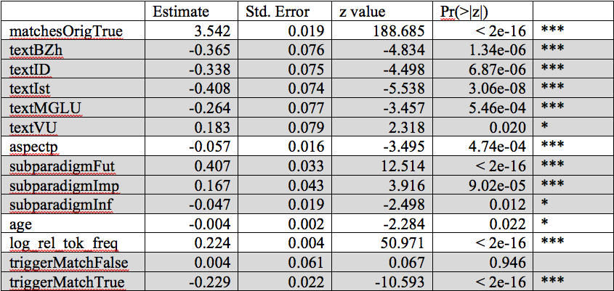
Results of mixed-effects ordinal regression model

Slide 20
Results of mixed-effects ordinal regression model
This means that original aspect vs. non-original aspect is by far the most important factor, so we can focus on that

Slide 21
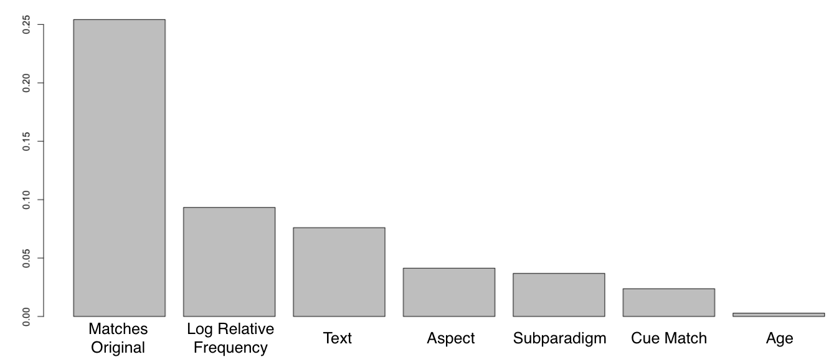
Random Forests Measure of Variable Importance

Slide 22
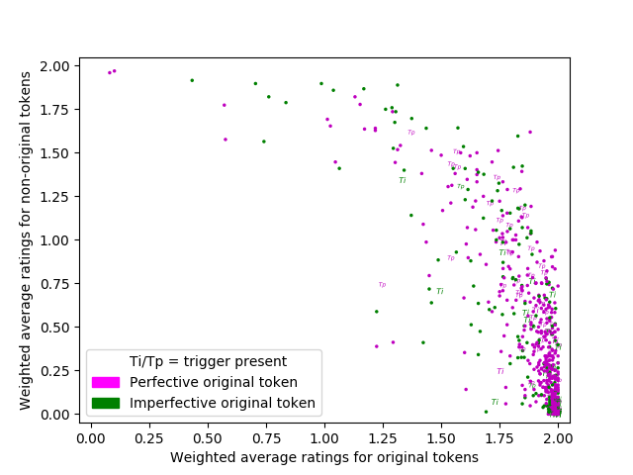
Redundancy vs. Construal

Slide 23
Redundancy vs. Construal
81% of the data is here.
Speakers reliably recover the original aspect.
Redundancy is HIGH.
Salience of construal is LOW.

Slide 24
Examples of test items where redundancy of aspect is HIGH and construal is LOW
V vosem’ let mal’čik [ ^{original}sbežal / ^{non-original}sbegal ] iz doma.
‘At the age of eight the boy ran away from home.’
Bogomol’naja ženščina nikogda ne [ ^{non-original}obrugala / ^{original}rugala ] ego
‘The pious woman never yelled at him’
 | Impossible = 0 | Acceptable = 1 | Excellent = 2 | Average
Perfective ^{original}sbežal | 0 | 0 | 83 | 2.0
Imperfective ^{non-original}sbegal | 69 | 12 | 2 | 0.193
Perfective ^{non-original}obrugala | 80 | 3 | 0 | 0.036
Imperfective ^{original}rugala | 0 | 0 | 83 | 2.0

Slide 25
Redundancy vs. Construal
17% of the data is here.
Speakers accept both aspects.
Redundancy is LOW.
Salience of construal is HIGH.

Slide 26
Examples of test items where redundancy of aspect is LOW and construal is HIGH
On umel nezametno [ ^{original}vytaščit’ / ^{non-original}vytaskivat’ ] den’gi iz karmana zevaki.
‘He knew how to pluck the money out of the pocket of an idler without being noticed.’
Vyživšuju iz uma staruxu nikto vser’ez ne [ ^{non-original}prinjal / ^{original}prinimal ]
‘No one took the senile old woman seriously’
 | Impossible = 0 | Acceptable = 1 | Excellent = 2 | Average
Perfective ^{original}vytaščit’ | 10 | 41 | 32 | 1.265
Imperfective ^{non-original}vytaskivat’ | 2 | 25 | 56 | 1.651
Perfective ^{non-original}prinjal | 9 | 31 | 43 | 1.410
Imperfective ^{original}prinimal | 4 | 25 | 54 | 1.602

Slide 27
Redundancy vs. Construal
The construal associated with aspect is entrenched through repeated exposure to examples where aspect is redundant due to the presence of contextual clues that align with aspect. Entrenchment makes the construal of aspect robust enough to express aspect even in the absence of supporting context.

Slide 28
Redundancy vs. Construal
But:
There are no groups in this data!
Participants react differently to original vs. non-original options.

Slide 29
Native speakers are less consistent in rating the non-original aspect
Fagov [ ^{non-original}podvergli / ^{original}podvergali ] polnogenomnomu sekveknirovaniju
‘The phages were subjected to full-gene sequencing’
 | Impossible = 0 | Acceptable = 1 | Excellent = 2 | Average
Perfective ^{non-original}podvergli | 24 | 25 | 23 | 0.986
Imperfective ^{original}podvergali | 2 | 13 | 57 | 1.764

Slide 30
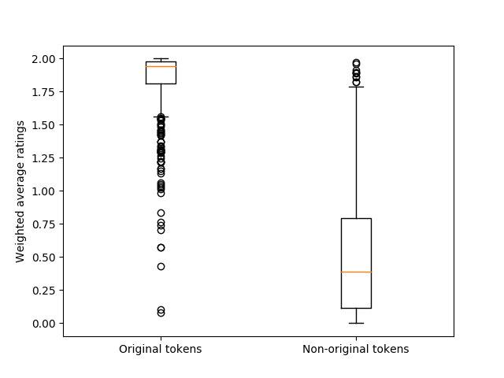
Distributions of average ratings for original vs. non-original items

Slide 31
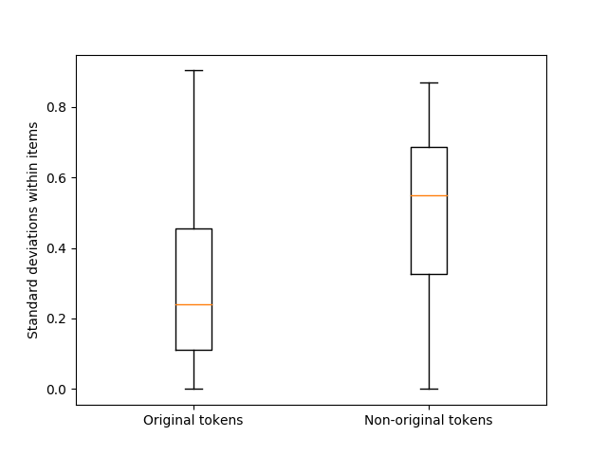
Standard deviations of ratings for original vs. non-original items

Slide 32
Native Speakers Differ in Their Choices, Especially When Reacting to Non-Authentic Language
This data gives evidence of divergence in the grammars of speakers
Native speakers are more reliable in reacting to authentic language, than in reacting to language that has been manipulated (here, by suggesting an aspectual form that does not match the original text)
This result may also have implications for how much linguists can rely on the intuitions of native speakers in reaction to constructed “examples” as opposed to authentic ones

Slide 33
Conclusions
Distribution of responses
81% of items received categorical responses, confirming that the original aspect was much preferred over the non-original aspect: here aspect is HIGHLY redundant
17% of items received similar ratings for both original and non-original aspect: here aspect is HIGHLY open to construal
Native speakers react very differently to original vs. non-original aspect in terms of consistency – responses for non-original aspect are much LESS consistent

Slide 34
What’s next:
Corpus data, experiments, and machine learning to ferret out and model the way that native speakers use context to select aspect
Discover differences between contexts where aspect is determined and where it is open to construal
Build effective resources for language learners

Slide 35
Selected Bibliography: Janda on Aspect
“A user-friendly conceptualization of Aspect”, Slavic and East European Journal, vol. 47, no. 2, 2003, pp. 251-281.
“A metaphor in search of a source domain: the categories of Slavic aspect”, Cognitive Linguistics, vol. 15, no. 4, 2004, 471-527.
“A Metaphor for Aspect in Slavic”, Henrik Birnbaum in Memoriam (=International Journal of Slavic Linguistics and Poetics, vol. 44-45, 2002-03; released 2006), 249-60.
“Aspectual clusters of Russian verbs”, Studies in Language 31:3 (2007), 607-648.
“Motion Verbs and the Development of Aspect in Russian”. Scando-Slavica 54 (2008), 179-197.
“Beyond the pair: Aspectual clusters for learners of Russian”, with John J. Korba, Slavic and East European Journal 52:2 (2008), 254-270.
“Semantic Motivations for Aspectual Clusters of Russian Verbs”. In Christina Y. Bethin, ed. American Contributions to the 14th International Congress of Slavists, Ohrid, September 2008. 2008. Bloomington, IN: Slavica Publishers. pp. 181-196.
“Xoxotnul, sxitril: The relationship between semelfactives formed with -nu- and s- in Russian”, with Stephen M. Dickey[1]. Russian Linguistics, 33: 3 (2009), 229-248.
“Prefixed Perfectives from Non-Determined Motion Verbs in Russian”, In: Viktoria Driagina-Hasko and Renee Perelmutter, eds. New Approaches to Slavic verbs of motion (= Studies in Language Companion Series 115). Amsterdam/Philadelphia: John Benjamins, 2010. pp. 125-140.
“Taking Apart Russian RAZ-”, with Tore Nesset. Slavic and East European Journal 54:3 (2010), 476-501.
“Two ways to get out: Radial Category Profiling and the Russian Prefixes vy- and iz-”, with Tore Nesset[1] and Anna Endresen[2]. Zeitschrift für Slawistik 56:4 (2011), 377-402.
“Russian ‘purely aspectual’ prefixes: Not so ‘empty’ after all?”, with Anna Endresen, Julia Kuznetsova, Olga Lyashevskaya, Anastasia Makarova, Tore Nesset, Svetlana Sokolova. Scando-Slavica 58:2 (2012), 231-291.
“Russkie pristavki kak sistema glagol’nyx klassifikatorov”. Voprosy jazykoznanija 6 (2012), 3-47.
“Semantic Profiles of Five Russian Prefixes: po-, s-, za-, na-, pro-”, with Olga Lyashevskaya. 2013. Journal of Slavic Linguistics 21:2, 211-258.
“Is Russian a verb classifier language?” In Gianina Iordăchioaia, Isabelle Roy, Kaori Takamine (eds.) 2013. Categorization and Category Change, 59-86. Cambridge: Cambridge Scholars Publishing.
“Russian Aspectual Types: Croft’s Typology Revised”. In: Miriam Shrager, George Fowler, Steven Franks, and Edna Andrews (eds.). 2015. Studies in Slavic Linguistics and Accentology in Honor of Ronald F. Feldstein, Bloomington, IN: Slavica Publishers, pp. 147-167.
“Predicting Russian Aspect by Frequency Across Genres”, with Hanne M. Eckhoff and Olga Lyashevskaya. Slavic and East European Journal, 2017.

